Slide 1
Sorting Searching
Yaratdı:Mammadov İbrahim

Slide 2
Fibonacci Search
In computer science, the Fibonacci search technique is a method of searching a sorted array using a divide and conquer algorithm that narrows down possible locations with the aid of Fibonacci numbers. Compared to binary search where the sorted array is divided into two equal-sized parts, one of which is examined further, Fibonacci search divides the array into two parts that have sizes that are consecutive Fibonacci numbers. On average, this leads to about 4% more comparisons to be executed, but it has the advantage that one only needs addition and subtraction to calculate the indices of the accessed array elements, while classical binary search needs bit-shift (see Bitwise operation), division or multiplication, operations that were less common at the time Fibonacci search was first published. Fibonacci search has an average- and worst-case complexity of O(log n) (see Big O notation).

Slide 3
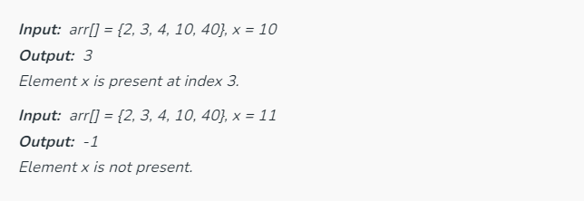
Fibonacci Search
Given a sorted array arr[] of size n and an element x to be searched in it. Return index of x if it is present in array else return -1.Fibonacci search is a comparison-based technique that uses fibonacci numbers to search an element in a sorted array.

Slide 4
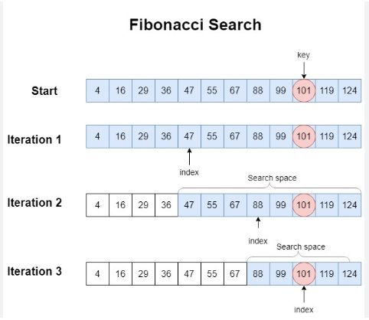
Fibonacci Search

Slide 5
Algorithm
Let k be defined as an element in F, the array of Fibonacci numbers. n = F_{m} is the array size. If n is not a Fibonacci number, let F_{m} be the smallest number in F that is greater than n.
The array of Fibonacci numbers is defined where F_{k+2} = F_{k+1} + F_{k}, when k ≥ 0, F₁ = 1, and F₀ = 1.
To test whether an item is in the list of ordered numbers, follow these steps:
Set k = m.
If k = 0, stop. There is no match; the item is not in the array.
Compare the item against element in F_{k−1}.
If the item matches, stop.
If the item is less than entry F_{k−1}, discard the elements from positions F_{k−1} + 1 to n. Set k = k − 1 and return to step 2.
If the item is greater than entry F_{k−1}, discard the elements from positions 1 to F_{k−1}. Renumber the remaining elements from 1 to F_{k−2}, set k = k − 2, and return to step 2.

Slide 6
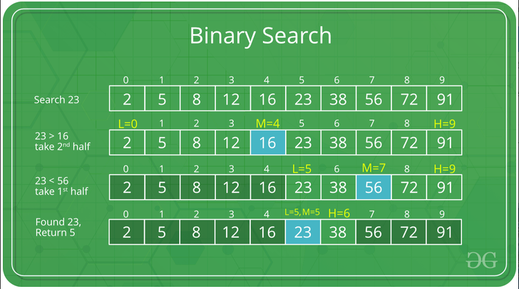
Binary Search
Binary Search is defined as a searching algorithm used in a sorted array by repeatedly dividing the search interval in half. The idea of binary search is to use the information that the array is sorted and reduce the time complexity to O(log N).

Slide 7
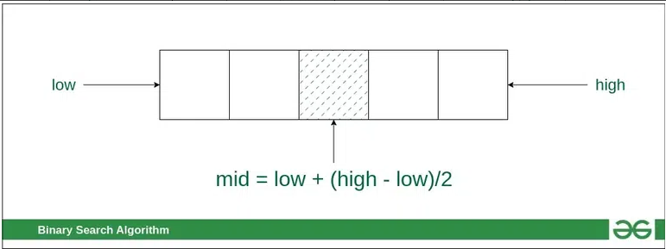
Binary Search Algorithm
In this algorithm,
Divide the search space into two halves by finding the middle index “mid”.
Compare the middle element of the search space with the key.
If the key is found at middle element, the process is terminated.
If the key is not found at middle element, choose which half will be used as the next search space.
If the key is smaller than the mddle element, then the left side is used for next search.

Slide 8
Jump Search
Like Binary Search, Jump Search is a searching algorithm for sorted arrays. The basic idea is to check fewer elements (than linear search) by jumping ahead by fixed steps or skipping some elements in place of searching all elements.
For example, suppose we have an array arr[] of size n and a block (to be jumped) of size m. Then we search in the indexes arr[0], arr[m], arr[2m]…..arr[km] and so on. Once we find the interval (arr[km] < x < arr[(k+1)m]), we perform a linear search operation from the index km to find the element x.
Let’s consider the following array: (0, 1, 1, 2, 3, 5, 8, 13, 21, 34, 55, 89, 144, 233, 377, 610). The length of the array is 16. The Jump search will find the value of 55 with the following steps assuming that the block size to be jumped is 4.
STEP 1: Jump from index 0 to index 4;
STEP 2: Jump from index 4 to index 8;
STEP 3: Jump from index 8 to index 12;
STEP 4: Since the element at index 12 is greater than 55, we will jump back a step to come to index 8.
STEP 5: Perform a linear search from index 8 to get the element 55.

Slide 9
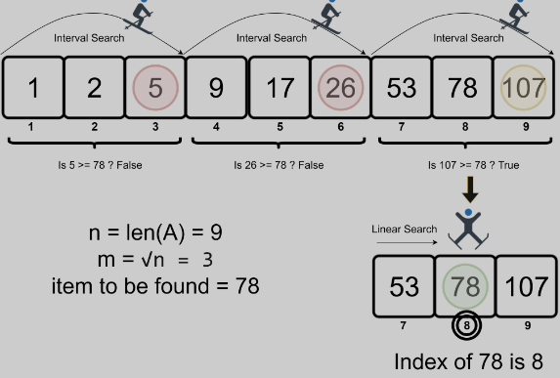
Algorithm steps
Jump Search is an algorithm for finding a specific value in a sorted array by jumping through certain steps in the array.
The steps are determined by the sqrt of the length of the array.
Here is a step-by-step algorithm for the jump search:
Determine the step size m by taking the sqrt of the length of the array n.
Start at the first element of the array and jump m steps until the value at that position is greater than the target value.
Once a value greater than the target is found, perform a linear search starting from the previous step until the target is found or it is clear that the target is not in the array.
If the target is found, return its index. If not, return -1 to indicate that the target was not found in the array.

Slide 10
Exponential search
In computer science, an exponential search (also called doubling search or galloping search or Struzik search) is an algorithm, created by Jon Bentley and Andrew Chi-Chih Yao in 1976, for searching sorted, unbounded/infinite lists. There are numerous ways to implement this, with the most common being to determine a range that the search key resides in and performing a binary search within that range. This takes O(log i) where i is the position of the search key in the list, if the search key is in the list, or the position where the search key should be, if the search key is not in the list.

Slide 11


Slide 12
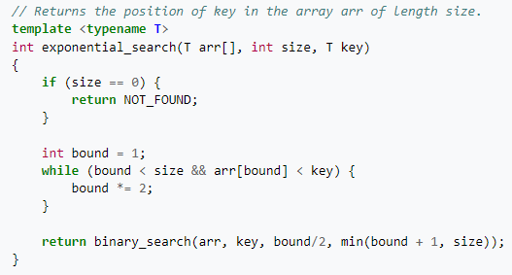
Algorithm
Exponential search allows for searching through a sorted, unbounded list for a specified input value (the search "key"). The algorithm consists of two stages. The first stage determines a range in which the search key would reside if it were in the list. In the second stage, a binary search is performed on this range. In the first stage, assuming that the list is sorted in ascending order, the algorithm looks for the first exponent, j, where the value 2j is greater than the search key. This value, 2j becomes the upper bound for the binary search with the previous power of 2, 2j - 1, being the lower bound for the binary search.

Slide 13
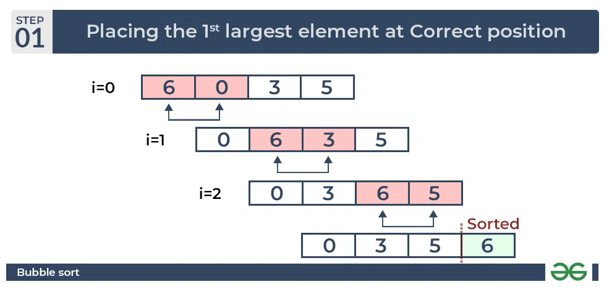
Bubble Sort
Bubble Sort is the simplest sorting algorithm that works by repeatedly swapping the adjacent elements if they are in the wrong order. This algorithm is not suitable for large data sets as its average and worst-case time complexity is quite high.

Slide 14
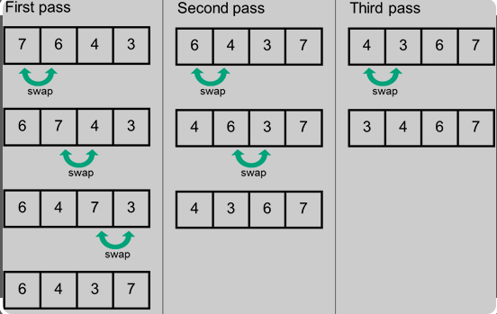
Bubble Sort Algorithm
In this algorithm,
traverse from left and compare adjacent elements and the higher one is placed at right side.
In this way, the largest element is moved to the rightmost end at first.
This process is then continued to find the second largest and place it and so on until the data is sorted.

Slide 15
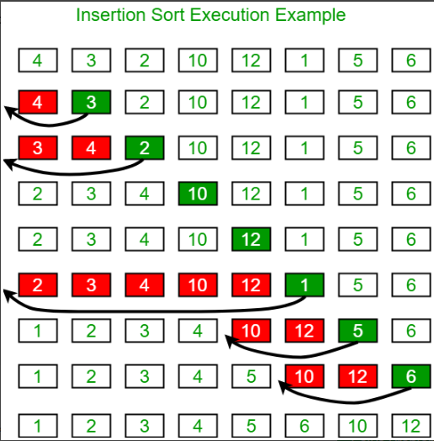
Insertion Sort
Insertion sort is a simple sorting algorithm that works similar to the way you sort playing cards in your hands. The array is virtually split into a sorted and an unsorted part. Values from the unsorted part are picked and placed at the correct position in the sorted part.

Slide 16
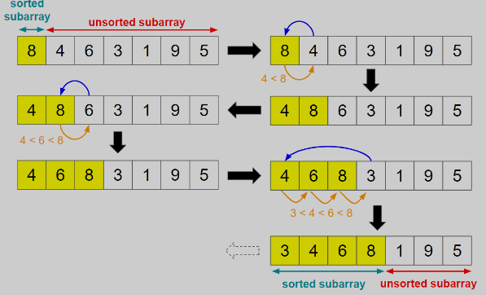
Insertion Sort Algorithm
To sort an array of size N in ascending order iterate over the array and compare the current element (key) to its predecessor, if the key element is smaller than its predecessor, compare it to the elements before. Move the greater elements one position up to make space for the swapped element.

Slide 17
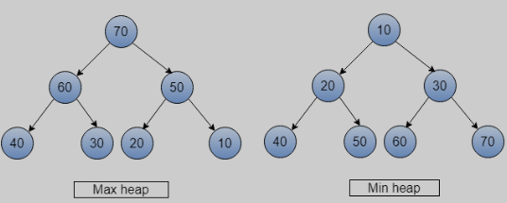
Heap Sort
Heap sort is a comparison-based sorting technique based on Binary Heap data structure. It is similar to the selection sort where we first find the minimum element and place the minimum element at the beginning. Repeat the same process for the remaining elements.

Slide 18
Heap Sort Algorithm
First convert the array into heap data structure using heapify, then one by one delete the root node of the Max-heap and replace it with the last node in the heap and then heapify the root of the heap. Repeat this process until size of heap is greater than 1.
Build a heap from the given input array.
Repeat the following steps until the heap contains only one element:
Swap the root element of the heap (which is the largest element) with the last element of the heap.
Remove the last element of the heap (which is now in the correct position).
Heapify the remaining elements of the heap.
The sorted array is obtained by reversing the order of the elements in the input array.

Slide 19
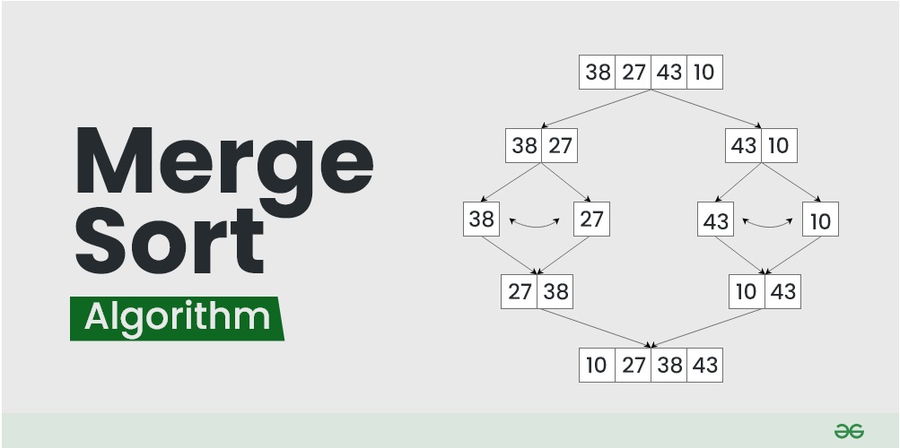
Merge Sort
Merge sort is defined as a sorting algorithm that works by dividing an array into smaller subarrays, sorting each subarray, and then merging the sorted subarrays back together to form the final sorted array.

Slide 20
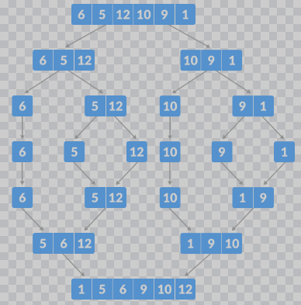
Merge Sort Algorithms
In simple terms, we can say that the process of merge sort is to divide the array into two halves, sort each half, and then merge the sorted halves back together. This process is repeated until the entire array is sorted.

Slide 21
SON

